Slide 1
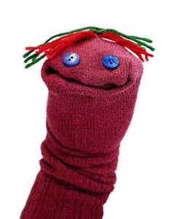
Create and Make!
Lets make a sock puppet!
Practice talking about what your child is doing…
“you’re cutting”
“those are the eyes”
“lots of long hair”

Slide 2
What you can do at home:
1. Take your puppet home & tell his story
“Your new puppet friend has come
to visit us at home, he does not know anything about home and does
not know many words. He has been collecting interesting
Items - can we help him learn?”
2. Your new puppet friend can collect interesting items at home and when you are out and about – parent could fill the box or child could fill the box!

Slide 3
What you can do at home:
3. Talk to your child (and the puppet) about the items…
It’s name “it’s an apple”
What its used for “we eat it for a snack!”
What it looks/feels like “its round and juicy”
Times when you’ve used one “I ate an apple this morning”
What the word sounds like “apple starts with a”
Top tips!
Let your child lead
Try to comment and discuss rather than asking lots of questions

Slide 4
What you can do at home:
4. Play!
Bring your new puppet into your play at home, re-enacting daily activities…
Comment on what your child is doing with the puppet
Let your child lead the play
Wait for your child to start the interaction
Repeat back things your child says, adding a word
Child: “puppet eating!”
Adult: “yes, puppet is eating a cake!”

